Slide 1
ABC Call Volume Trend Analysis
By Atinderbir Pannu

Slide 2
DESCRIPTION
This project delves into Customer Experience (CX) analytics, focusing on the inbound calling team of a company. Utilizing a 23-day dataset, key metrics such as agent details, queue times, call durations, and statuses are explored. The CX team's vital responsibilities encompass analyzing feedback, managing programs, and mapping customer journeys. Through the utilization of AI-powered tools like IVR and Predictive Analytics, the goal is to optimize inbound customer support, nurturing loyalty and advocacy for the business.

Slide 3
TECH-USED
Ms-Excel 2021
Ms-Powerpoint 2021

Slide 4
Approach
Processed dataset according to project tasks, addressing problem statement and analysis approach.
Calculated average call duration for incoming calls per agent, determining necessary agent count and total manpower for customer attendance.
Applied Excel methodologies and concepts to execute analysis, ensuring accurate results and creating necessary charts.
Presented comprehensive approach to analysis, utilizing Excel tools effectively.
Compiled brief project report summarizing findings and methodologies used.

Slide 5
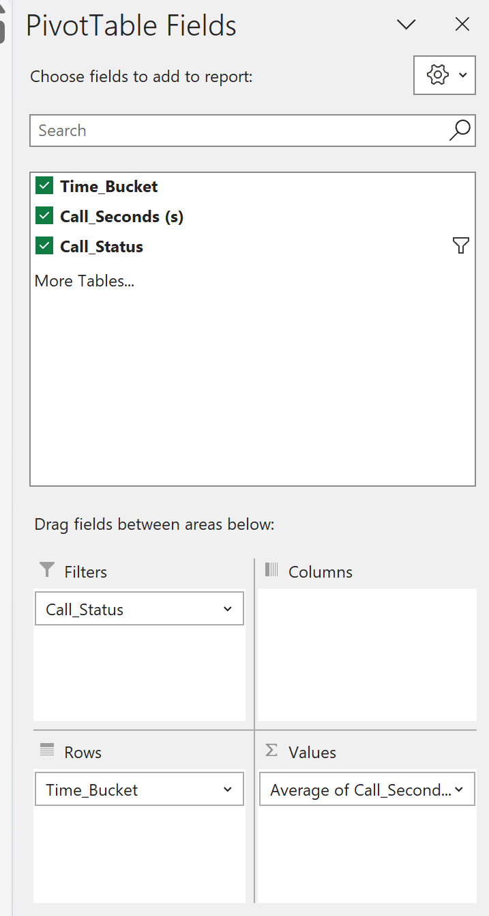
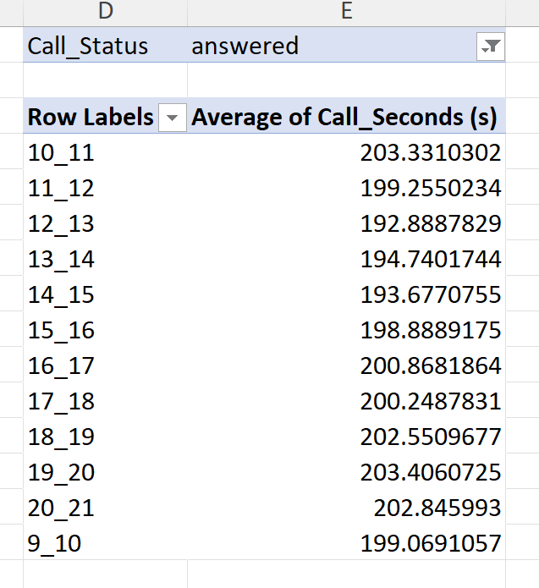
Task 1: Average Call Duration: Determine the average duration of all incoming calls received by agents. This should be calculated for each time bucket.

Slide 6
The highest average durations occur between 10 am to 11 am and 7 pm to 8 pm, while the lowest average durations are observed between 12 pm to 1 pm. These findings aid in understanding peak and off-peak call handling periods.

Slide 7
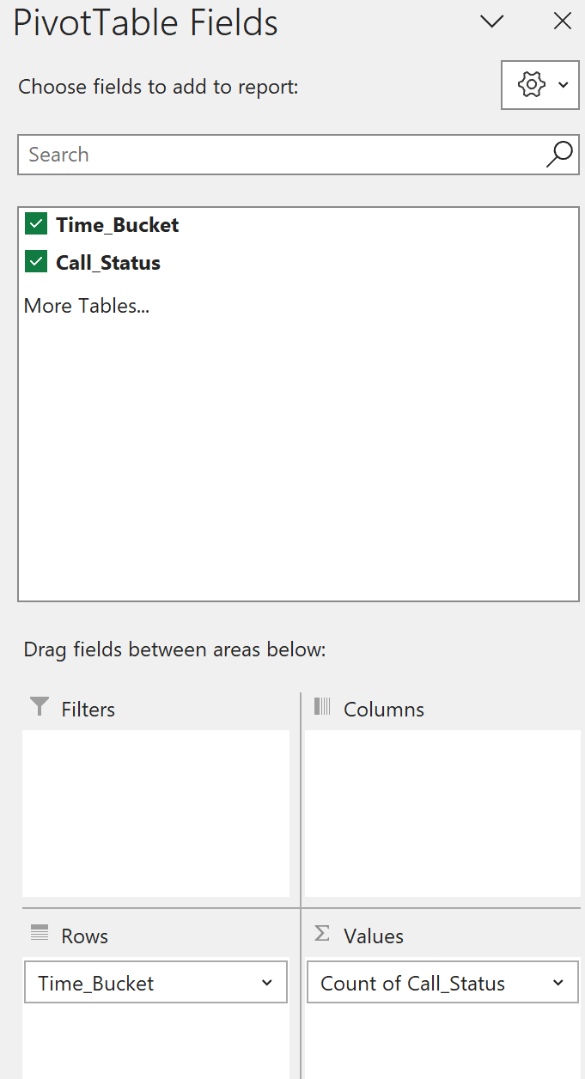
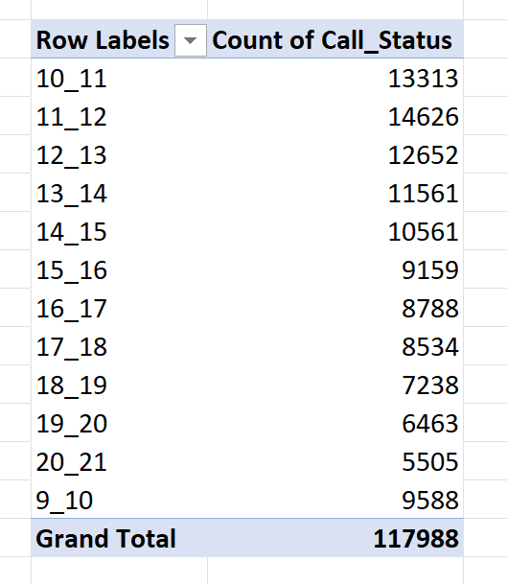
Task 2: Call Volume Analysis: Visualize the total number of calls received. This should be represented as a graph or chart showing the number of calls against time. Time should be represented in buckets (e.g., 1-2, 2-3, etc.).

Slide 8
Analysis indicates peak customer call activity between 11 am to 12 noon, with a decline during 8 pm to 9 pm.

Slide 9
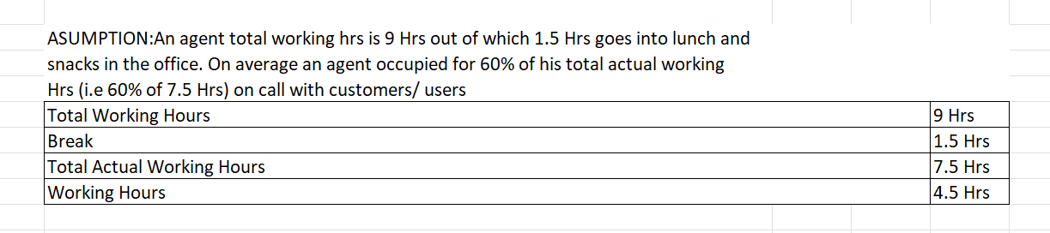
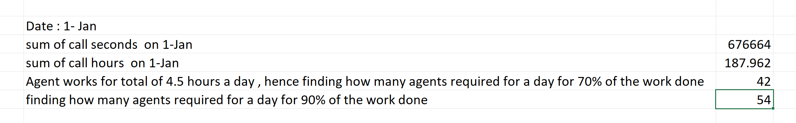
Task 3: Manpower Planning: The current rate of abandoned calls is approximately 30%. Propose a plan for manpower allocation during each time bucket (from 9 am to 9 pm) to reduce the abandon rate to 10%. In other words, you need to calculate the minimum number of agents required in each time bucket to ensure that at least 90 out of 100 calls are answered.

Slide 10
Row Labels | Count of Call_Seconds (s) | % of call of seconds | Column1 | Agents required
10_11 | 13313 | 11.28% | 0.11 | 6
11_12 | 14626 | 12.40% | 0.12 | 7
12_13 | 12652 | 10.72% | 0.11 | 6
13_14 | 11561 | 9.80% | 0.10 | 5
14_15 | 10561 | 8.95% | 0.09 | 5
15_16 | 9159 | 7.76% | 0.08 | 4
16_17 | 8788 | 7.45% | 0.07 | 4
17_18 | 8534 | 7.23% | 0.07 | 4
18_19 | 7238 | 6.13% | 0.06 | 3
19_20 | 6463 | 5.48% | 0.05 | 3
20_21 | 5505 | 4.67% | 0.05 | 3
9_10 | 9588 | 8.13% | 0.08 | 4
Grand Total | 117988 |  |  | 54
To achieve a 90% call connection rate, approximately 54 agents are needed, calculated using the provided formula and average daily call volume. Hence,12 more agents are required to calculate the minimum number of agents required in each time bucket to ensure that at least 90 out of 100 calls are answered.

Slide 11
Task 4:Night Shift Manpower Planning: Customers also call ABC Insurance Company at night but don't get an answer because there are no agents available. This creates a poor customer experience. Assume that for every 100 calls that customers make between 9 am and 9 pm, they also make 30 calls at night between 9 pm and 9 am.
Considering the provided data:
The average incoming calls are 5130, with 30% of calls occurring at night, which is 1539 .
The average seconds required to answer the calls at night are 305676.18.
This translates to approximately 84.91 hours required to answer calls.
Adjusting for a 90% efficiency rate, the actual hours required become 76.42.
With this calculation, approximately 17 agents are needed to handle the workload effectively.

Slide 12
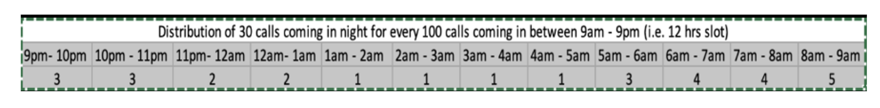
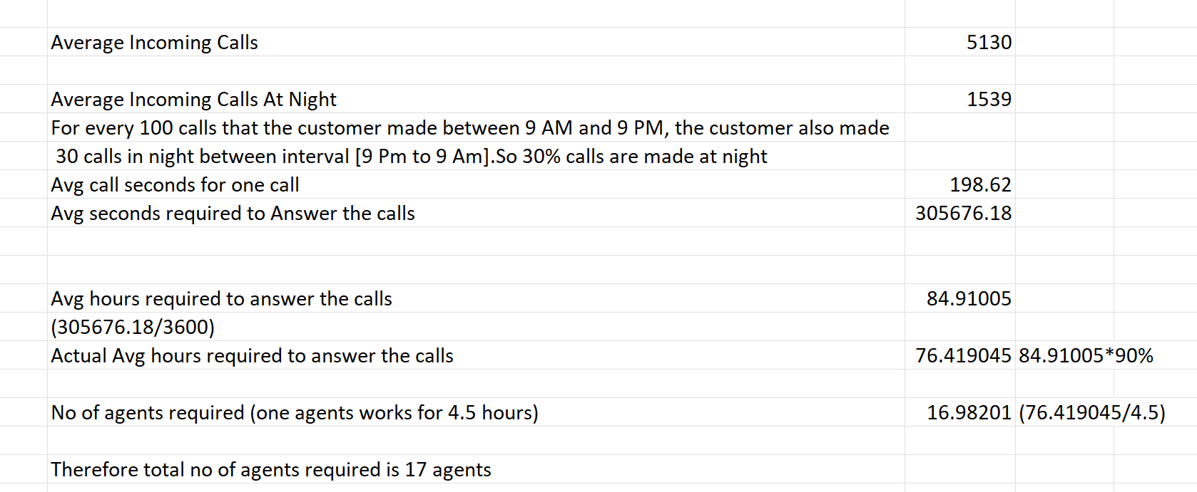
Time Bucket | Calls | Time Distribution | No of agents
9pm- 10pm | 3 | 0.10 | 2
10pm - 11pm | 3 | 0.10 | 2
11pm- 12am | 2 | 0.07 | 1
12am- lam | 2 | 0.07 | 1
1am - 2am | 1 | 0.03 | 1
2am - 3am | 1 | 0.03 | 1
3am - 4am | 1 | 0.03 | 1
4am - 5am | 1 | 0.03 | 1
5am - 6am | 3 | 0.10 | 2
6am - 7am | 4 | 0.13 | 2
7am - 8am | 4 | 0.13 | 2
8am - 9am | 5 | 0.17 | 3
Total | 30 | 1.00 | 17

Slide 14
RESULT
Throughout this project, I've gained insights into the analyst's impact on customer service, emphasizing the company's goal of maximizing satisfaction.
Utilizing tools like IVR, powered by AI, facilitates efficient customer query resolution.
Pre-calculated time buckets and call durations converted into seconds streamline data analysis. Exploring behavioral analytics uncovers trends and preferences, enhancing overall customer experience.
This project enriches understanding of customer service dynamics and the analyst's role in fostering satisfaction.

Slide 15
THANK YOU Excelsheet LINK

